Slide 1

HS School-Based Health Lessons

Slide 2
Our Lessons
Lesson(s) are designed to supplement a health unit.
Each lesson is designed for one 40-45 min period.
We would prefer a classroom environment.
Lessons are interactive and will explore the essential questions and learning goals with lots of discussions, scenarios, and role-plays.

Slide 3

Healthy Relationships
Essential Question
What is the standard for the people you let into your life?
Learning Goals
Name and contrast qualities of healthy and unhealthy relationships with people.
Identify characteristics of healthy relationships with people.
Identify healthy boundaries a person can set in relationships with people.

Slide 4

Dating Violence Prevention
Essential Question
Why do people stay and get into unhealthy relationships?
Learning Goals
Name and contrast qualities of unhealthy and dangerous relationships.
Develop a plan for healthy relationships.
Discuss the importance of respect and boundaries.
Love Shouldn’t Hurt

Slide 5

Sexting and Relationships
Essential Question
What are the risks and potential consequences of sexting?
Learning Goals
Compare the risks and benefits of self-disclosure in relationships.
How to make a healthy decision about sexting.
Understand consent and refusal skills.
Use scenarios to identify to potential risks and consequences of sexting.

Slide 6


STI and Pregnancy Prevention
Essential Question
What are the steps someone can take to stay protected from STI’s and pregnancy?
Learning Goals
Define elements of consent in sexual settings
Review common sexually transmitted infections (STIs)
Discuss protection methods
Discuss abstinence and postponement
I will commit to practice
healthy and safe behaviors for my future

Slide 7

Consent and Healthy Relationships
Essential Question
Why is consent important for healthy relationships and sexuality?
Learning Goals
Discuss consent as an important part of healthy relationships and healthy sexuality.
Define sexual assault.
Discuss refusal skills and put into practice.
Identify the five components of consent in a scenario.
Identify personal boundaries

Slide 8
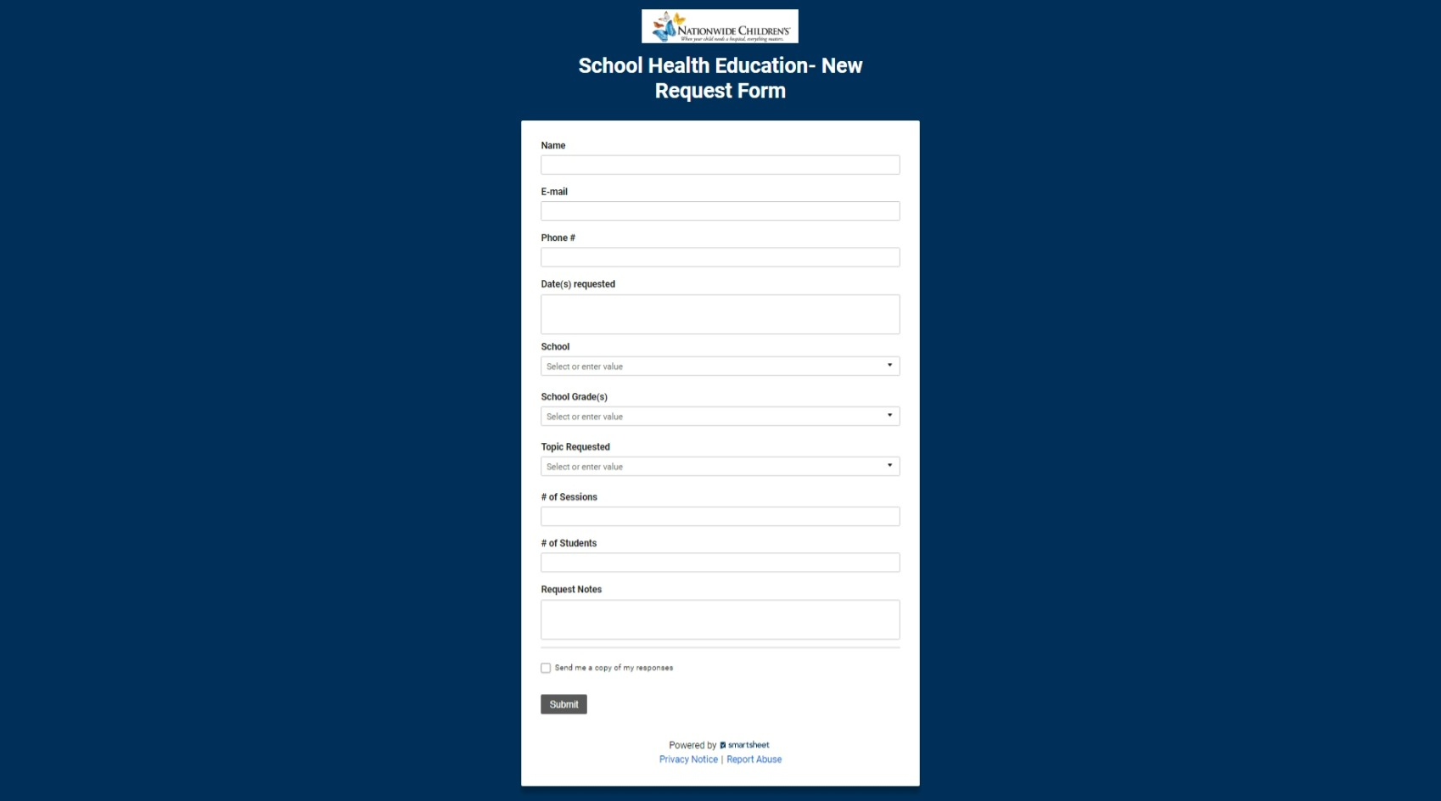

Slide 9

Future Happenings
The school-based health program is considering expanding the HS Sex Ed curriculum.
The model would look like what we are currently implementing into the middle schools.

Slide 10
Contacts
Sarah Saxbe
sarah.saxbe@nationwidechildrens.org
Dominick Mazza
dmazza@columbus.k12.oh.us

